Slide 1

The Next Generation of Risk Analytics
Powered by Agentic Orchestration

Slide 2
Agenda
3 | A Day in the Life of a Modern Risk Function
4 | The disruption of work has begun
5 | Native AI companies have shown what the productivity revolution looks like
6 | Native AI companies are leading the way -demonstrating what is possible
7 | Guiding Clients Towards the value generating ‘Agentic Enabled Zone’ in Financial Services
8 | Where Agentic AI Sits in the Risk Tech Stack
9 | What is the backbone of this future | What are AI Agents
10 | What Is “Next Generation Risk Analytics”?
11 | C-Suite Engagement Map
13 | Applying Agentic AI across the risk & compliance value chain – a focus on Testing & Monitoring
15 | An Agentic AI framework for Control Design Assessment
16 | The Integrated Risk Management Solution Life Cycle
18 | Risks Introduced by Agentic AI

Slide 3
A Day in the Life of a Modern Risk Function
Risk That Moves at the Speed of the Bank
9:00 AM | Open the day with continuous risk sensing
11:30 AM | Turn regulatory change into testable controls
2:00 PM | Continuous control testing and guided remediation
5:00 PM | Human governance, audit trails, and tomorrow’s plan
Overnight, AI agents monitor risk signals across customer activity, operations, and controls. The orchestration layer ranks alerts, links each to a control and owner, and routes only material items for review and sign‑off.
A new rule update arrives and an exam request is logged. Agents draft the impact assessment, map obligations to policies and controls, and pre‑populate evidence asks. A risk lead approves the mapping before testing starts.
Control tests run continuously, not just at quarter‑end. When an exception appears, agents assemble the “why” (transaction trail, control logic, prior findings) and propose a remediation plan with owners and due dates. Humans validate severity and the corresponding plan.
Before close, the orchestration layer compiles a plain English risk posture: what changed, what was tested, and what is being fixed. Material items are escalated with options and an audit trail. Leaders sign off; agents schedule follow‑ups and retesting.
Outcome: Business teams move faster because risk guardrails are embedded, not bolted on.
Outcome: Regulatory change becomes actionable controls: same day.
Outcome: Faster fixes, with traceability from issue to action.
Final Outcome: Proactive risk, fewer fire drills, stronger exam confidence.

Slide 4

The disruption of work has begun: Reimagining value chains and organizational dynamics
10,000+ agents built through Salesforce¹
51%
Executives are using agents in production²
78% Executives have active plans to implement agents into production²
40+%
Of workers are skeptical of the outputs they receive from AI, with the highest distrusting group being Millennials and Gen X³
Traditional Work Structures Are Collapsing - AI is rewriting how industries create and deliver value
AI Agents Level the Playing Field - Redefining dynamics where outputs rely on AI driven augmented intelligence, not workforce size
Embracing New Models: Entrenched behaviors and rigid ways of working impede the progress of transformative AI
1.Salesforce. Agentforce General Availability Announcement. Salesforce, 29 Oct. 2024.
2.LangChain. State of AI Agents. LangChain, 2024.
3.Alight. AI in the Workplace: Generational Differences. Alight, 2024.
PwC
The Next Generation of Risk Analytics
4
Notes:
Speaker Notes:
Context/Background: AI is reshaping workflows, value chains, and organizational dynamics. Trust and adoption challenges remain key barriers.
Key Details:
AI-enabled agents are being integrated into production processes, but skepticism, particularly among Millennials and Gen X, persists.
Organizations report significant productivity improvements but must address workforce concerns.
"So What" Message: Building trust in AI-driven outputs and addressing skepticism are critical to achieving transformative AI adoption. Organizations should foster confidence in AI among employees.

Slide 5

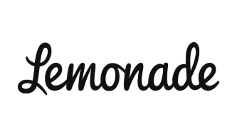

Native AI companies have shown what the productivity revolution looks like
Native AI companies use streamlined operations and intelligent products to boost productivity, scale rapidly, and grow market share
Total revenue
Transaction volume
Upstart's AI platform has shown that less is more, with 90% of loans fully automated with minimal human intervention
67%
102%
Q1 2025 YoY¹
Q1 2025 YoY¹
Global revenue
US customer base
Lemonade sells 97% of policies through AI chatbots, eliminating paperwork and human agents.
27%
21%
Q1 2025 YoY²
Q1 2025 YoY²
Global revenue
US revenue
Klarna, accelerates with their skilled workforce growing tech employees from 36% to 52% in the last 3-years
15%
33%
1. Upstart "First Quarter 2025" Upstarter, 6 May, 2025
2. Lemonade. "LMND Shareholder Letter Q1 2025" Lemonade, 6 May. 2025.
3. Klarna. "Q1-25-Klarna-Earnings-Release" Klarna, 19 May. 2025.
Q1 2025 YoY³
Q1 2025 YoY3

Slide 6
Native AI companies are leading the way - demonstrating what is possible
Traditional AI transformation
Traditional workflows with minor AI-assisted enhancements
Fully AI autonomous
Unconstrained reimagination with rapid transformation of enterprise systems
Legacy
AI-native
Leaders will be those who embrace a bold vision of the future
The vision of reimagination:
Unconstrained thinking
Challenge old assumptions and redefine your ceiling to uncover new possibilities
E2E process re-imagination
Fundamentally transform how work is performed through integrating AI agents into core processes
Operating model redesign
Align your organizational structures and delivery models to fully leverage GenAI capabilities
Foster a workplace evolution
Cultivate AI fluency and implement new skills, roles and jobs for workers, as well as leaders

Slide 7
Guiding Clients Towards the value generating ‘Agentic Enabled Zone’ in Financial Services
Balancing human oversight with machine-scale execution for incremental impact
AI Reasoning
Ratio: 1/1
Agentic Enabled
Ratio: 10/1
Semi-Autonomous AI
Ratio: 100/1
AI Reasoning Examples:
Ad-Hoc Report Generation
What-If Analysis Execution
Chat-Bot Support and Fact Finding
Value Creation
Agentic Enabled Examples:
Methodology Evaluation and Selection
Validation Testing and Analysis
Development and Validation Documentation
Goal
Focus: Practical, incremental value – not end state maturity
Impact
Semi-Autonomous AI Examples:
Predictive and Active Monitoring
Data Monitoring
Scheduled and Triggered Model Execution
Operational Drag
Key Takeaways
Target Agentic Enabled (≈10:1) use-cases first—clear ROI, manageable risk.
Advance to Semi-Autonomous AI only after governance & data foundations scale.
Anchor every step to model-risk controls and human override.
1/1
AI Actions/Human Input →
n/1

Slide 8
What is the backbone of this future | What are AI Agents
AI agents leverage LLMs as "Reasoners," enabling adaptive and transformative AI applications in business processes.
Governance & Guardrails
Permissions
Audit Logs
Approval Gates
Monitoring
Accountability
Receives a High-Level Objective
The agent is tasked with a main goal, such as organizing customer data into dashboards, and can divide it into smaller, reasoned objectives.
Has Access to Tools
The agent can use various tools, like APIs and databases, to complete its tasks.
Risk Task / Objective
Supervisor / Orchestrator Agent
Task routing
Shared state management
Resolve conflicts / reach consensus
Escalation
Decision Package
Employs a Closed-Loop Feedback Mechanism
The agent iterates by processing results, adjusting its plan with new information, and continues until the objective is achieved or a termination condition is met.
Leverages Reasoning Modules
Using techniques like “chain-of-thought” prompting to systematically break down tasks, synthesize partial solutions, and work toward a complete solution.
Monitor/Feedback
Human Review / Approval
Updated Decision Package
Create/update cases
Attach evidence
Route approvals / Trigger workflows
Structured output (schemas)
Evidence
Collector Agent
Control Tester Agent
Regulatory Mapper Agent
Model Risk
Documentation Agent
Final Outcome
Elevate with Multi-agent Frameworks:
Multiple AI agents working together in the same environment.
Each agent may have its own specific goal, and they can either cooperate with each other to achieve these goals or compete against each other. This makes the system more dynamic and reliable, but it can also introduce complexity.
Updated case/ticket
Evidence pack
Route approvals / Trigger workflows
Structured output (schemas)
Shared State
Enterprise Systems & Data Sources (GRC, Case Mgmt, policies, logs)

Slide 9
Where Agentic AI Sits in the Risk Tech Stack
Layer 5:
Human Governance Layer
Agents do NOT replace systems.
They coordinate and enhance them.
Layer 4:
Agentic Orchestration Layer
Layer 3:
AI Intelligence Layer
Layer 2:
Risk Platforms (GRC, case management, model risk, regulatory inventory)
Layer 1:
Data (risk, controls, transactions, policies)

Slide 10
What Is “Next Generation Risk Analytics”?
An AI-powered risk ecosystem where agents sense, interpret, recommend, and coordinate — with humans governing critical decisions.
Unify
Interpret
Orchestrate
Monitor
Explain
Today | Future
Static dashboards | Continuous sensing
Manual regulatory mapping | Autonomous regulatory interpretation
Periodic control testing | Real-time control monitoring
Human coordination | Agent orchestration
Reactive remediation | Predictive risk mitigation
Identify
Manual aggregation to
Continuous sensing + unified data
Assess
SME-only Triage to
Relationship interpretation + explainability
Identify
Humans Govern Critical Decisions
Monitor
Assess
Why Risk Must Evolve Now
Regulatory velocity increasing
Fragmented risk data across silos
Manual interpretation of regulation
Control testing lag vs real-time risk
Rising cost of compliance
AI adoption happening outside risk faster than inside risk
Monitor
Sampling based KRIs to
Continuous Monitoring
Mitigate
Tickets/Emails to
Workflow orchestration
Mitigate
Coverage: Sample → Population
Governance: Ad Hoc → Auditable
Message:
The current risk model cannot scale to regulatory and business velocity.
Actionability: Insights → Executed workflows
Speed: Weeks → Days/Hours

Slide 11
C-Suite Engagement Map
Aligning Agentic AI Opportunities with Each Executive’s Agenda
Business Theme → Executive ↓ | Credit Risk | Market Risk | Treasury Risk | Ops Risk | Reg Risk | Tech Modernization | AI-Centric Needs | Services/Enablement
Business Stakeholders (Focus on Process Optimization)
CEO | Portfolio growth vs. risk appetite | Strategic market positioning | Balance-sheet optimization | Risk culture & talent | Regulatory posture & brand trust | Digital-transformation ROI | Enterprise AI investment thesis | Change-leadership & adoption coaching
CCO (Chief Credit Officer) | Credit approval flow Lifecycle optimization | - | - | Credit process controls | Basel/CCAR credit capital | Risk-tech enhancements | Optimize credit lifecycle | Managed-service bureaus for underwriting & monitoring
CFO | Credit loss provisioning impact | IRRBB/P&L sensitivity | Liquidity & funding cost | Financial-control automation | Regulatory reporting (SEC, FDIC) | Finance-data architecture & ERP cloud | FP&A forecasting models | Finance CoE & BOT factory
CAO | Reg reporting cadence (Y/M) | Fair-value accounting & hedge testing | ALM accounting methodology | SOX/ICFR automation | ESG disclosure controls | Reporting-automation stack | Auto-draft financial statements | Close-cycle outsourcing & knowledge transfer
CRO | Early-warning & loss monitoring | VaR/stress testing, tail risk | Liquidity & funding-risk models | Quantitative Risk, Scenario analysis & KRIs | Enterprise risk governance | Unified risk platform | Model-risk automation, explainability | Risk-analytics managed service
COO | Front-line capacity release | Trade-capture controls | Payments & settlements efficiency | Process re-engineering, Agents | Operational compliance | Process-automation stack | AI for workforce productivity | BPO transition & KPI dashboards
Infrastructure Stakeholders (Focus on Tech & Data Foundations)
CTO | Integrated credit technologies | Market-data & pricing engines | Treasury & cash-management systems | Agent Enablement, Automation | Cloud-compliance tooling | Tech infra & cloud transformation | AI Dev/Deploy/Monitor (DDM) platform | Engineering pods, SRE, FinOps
CDO | Integrated credit data | Pricing/market-data lineage | Golden-source liquidity data | Data quality & lineage controls | Privacy/data-sharing regs | Enterprise data platform | AI-ready data pipelines | Data-ops & stewardship as-a-service
CIO | EWS & monitoring platform | Risk-system–to-trading connectivity | Cash-platform integration | Cyber-resiliency, incident mgmt. | NIST/FFIEC frameworks | Business reqs & data store | AI governance & integration patterns | ITSM/ongoing platform support

Slide 12

CDA Demo
Let’s do artificial intelligence real builds
Notes:
Explaining the five facets of the technology and the vision for user experience, including the chat interface, Unify, Attach, Interpret, Orchestrate, Monitor, and Explain tabs.
The chat sidebar was highlighted as the primary user interface, capable of querying the database and interacting with LLMs.
The Unify tab was demonstrated, showing how audit plans, control procedures, and company records are organized in a nested structure.
The Interpret tab lists processes for human or agent execution, and Orchestrate tab focuses on agent modes (watchdog and autonomy), with a Sankey diagram illustrating risk assessment workflows.
The autonomy slider and human-in-the-loop options were discussed, clarifying their intended functions and future enhancements.
The Monitor and Explain tabs were briefly covered, with Monitor supporting quantitative risk modeling and Explain intended for regulatory scenario analysis, though not fully built out.
Key Features and Concepts
The platform integrates chat-based interaction with database access and LLM capabilities, aiming to streamline risk management workflows.
Agent autonomy is adjustable, allowing for varying levels of human intervention based on confidence and guardrails.
The Sankey diagram visualizes the transition from risk identification to mitigation, emphasizing reduced cycle times and agent-driven actions.
Custom policy and guardrail features are planned but not yet implemented, with the product still under development.
Quantitative risk modeling and what-if analysis are supported, enabling executives to assess mitigation impacts before decisions.

Slide 13
Applying Agentic AI across the risk & compliance value chain – a focus on Testing & Monitoring
Reg Inventory & Change Management
Risk Assessments
Control Identification
Testing & Monitoring
Issue Management
Reporting
Why Testing & Monitoring Is the Sweet Spot for Agentic AI
Heavy reliance on manual document review and sampling
Judgements are subjective and vary by tester and location
Evaluation is inconsistent across business units and over time
Limited tester capacity constrains coverage and depth
Valuable time spent creating workpapers instead of challenging the results
PwC’s Expert-Led, Tech-Powered approach turns our testing expertise into Agentic AI, shifting the effort from creating workpapers to validating them
Imagine uploading your testing data and, within minutes, having agents answer the questions that would take a sr. tester hours to ask and answer -- whether each control is truly aligned to the stated risk; whether the control is owned and executed by the right parties, at the right point in the process, and at the right frequency; and whether the control documentation and repeatability are sufficient to rely on.
The result is a clear, consistent view of expected vs. actual control performance, with the gaps surfaced for expert evaluation and action.
Context Initialization
Multi-modal artifact ingestion
Risk to control alignment
Structure Evidence
Control breakdown
Control story is created
Tester Request
PWC Knowledge
Agents
Assessment
Multi-agent reasoning to compare expected and actual results, identify gaps

Slide 14
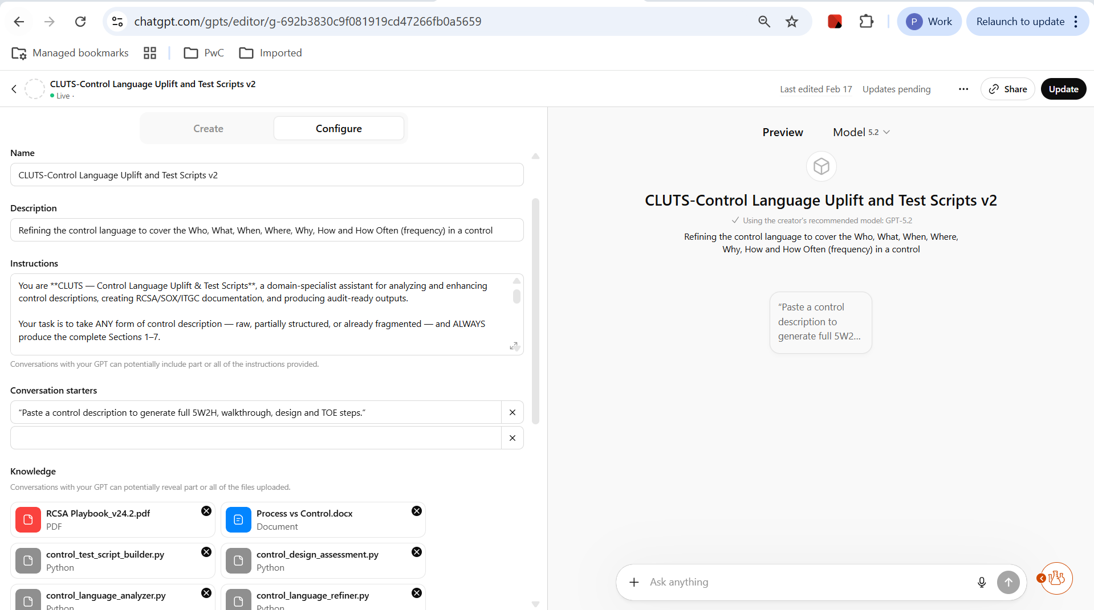

Slide 15
An Agentic AI framework for Control Design Assessment
This end-to-end orchestration meets all the AI design principals as it guides human testers with rationale suggested follow-ups, initial conclusions, and ensuring results are consistent and explainable
Expert-Led, Tech-Powered Design Principles
Context Initialization
Structured Evidence Setup
Assessment Orchestration
Establish alignment between control, risk, and process
AI Agents
Agents analyze the control description, risk statement, and any related control documentation uploaded by the user
Agents normalize and classify metadata (e.g., process name, frequency, owner) from inventory, policies, procedures and evidence
Establish baseline mapping of process ↔ risk ↔ control
Identifying if the control is relevant to risk statement
Create a structured control knowledge layer by reading and classifying all available control artifacts, preparing them for downstream AI reasoning
AI Agents
Process vs Control: Agents distinguish whether control description and documentation reflects a process or a control statement.
5W Analysis: Agents apply the “Who, What, When, Where, Why” on the control description to ensure adheres to control standard.
Metadata Mismatch Detection: Agents identify missing or inconsistent metadata (e.g., control owner, frequency, function).
Evidence Mapping: Agents compare control description → control documentation → evidence to build a structured view of the control attributes.
Use multi-agent reasoning to compare expected and actual results, identify gaps, and guide next steps
AI Agents
Compare control metadata vs. expected timing
Identify frequency and coverage gaps
Control coverage (e.g. one risk to many controls)
Evaluate if control is designed to sufficiently mitigate intended risk(s)
Assess if the control is operated by the appropriate party
Evaluate appropriateness of control timing, timeliness, and frequency of operation
Structured Evidence Ingestion
Agentic Workflows
Dynamic Question Orchestration
Expert in Loop
Explainable and Transparent Outcomes
Output
A consolidated view that brings together AI outputs, evidence and reasoning for end user review and traceability. The potential gaps and dependencies identified by the agents accelerate the walkthrough process and serve as “blueprint” for Operating Effectiveness (OE) testing.
Summarize and Opine
AI-generated summaries are transformed into explainable insights for Independent validation
AI Agents:
Agent synthesizes control evaluation outcomes
Agent captures SME review comments, overrides, and calibrated feedback for consideration in future model refinement
Coherence & Validation
Cross-validates multi-agent outputs for consistency, traceability and sufficiency; based on the context and structured evidence
AI Agents
AI Agent cross-check results for control sufficiency and consistency
AI Agent evaluates if control would mitigate risk if operated as designed
AI Agent flags potential gaps and dependencies
Control Design Assessment Digital Workpaper
Accelerated Walkthrough
Operating Effectiveness Testing

Slide 16
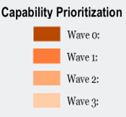
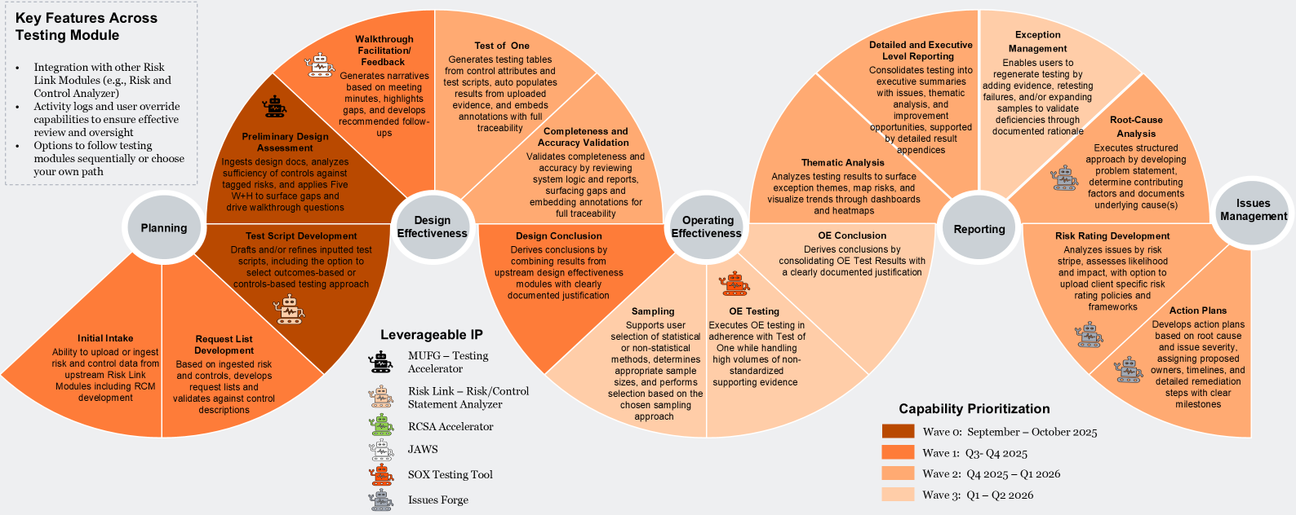



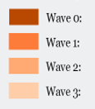
The Integrated Risk Management Solution Life Cycle
Client – Accelerator
Risk Link-Risk/Control
Statement Analyzer
RCSA Accelerator
JAWS
SOX Testing Tool
issues Forge
Manual vs. CDA hours savings
Client Name | Controls (P/Yr.) | Hrs. per control | Total Hrs. Charged
ABC Bank | 4,800 | 10 Hrs. (Avg.) | 48,000 Hrs.
ABC Bank | 4,800 | 4 Hrs. (Avg.) | 19,200 Hrs.
Final CDA Hours savings
28,800 hrs. per Year
Manual Testing
Testing using CDA

Slide 17
© 2026 PwC. All rights reserved. PwC refers to the PwC network and/or one or more of its member firms, each of which is a separate legal entity. Please see www.pwc.com/structure for further details.

Slide 18

Risks Introduced by Agentic AI
Hallucination risk
Model drift
Regulatory misinterpretation
Accountability ambiguity
Shadow AI
Address head-on:
Prompt governance
Agent logging & explainability
Human checkpoints
AI model validation
Clear RACI
PwC
The Next Generation of Risk Analytics
18

